Slide 1

HSDT – Plugin Opponent Deck Guesser

Slide 2
0 - Intro
Powered via API calls to HSReplay.net, the developer of HSDT
HSReplay.net contains the most up to date info on the current meta captured by users of the HSDT

Slide 3
1 – Logging In
When launching HSDT / turning on the plugin a chrome instance will launch prompting you to login to HSReplay.net
If you have a FREE account OR only want Bronze, Silver, or Gold Stats and Deck Lists you can simply cross this out
If you have a PREMIUM account AND want Platinum, Diamond, or Legendary Stats and Deck Lists you must login

Slide 4
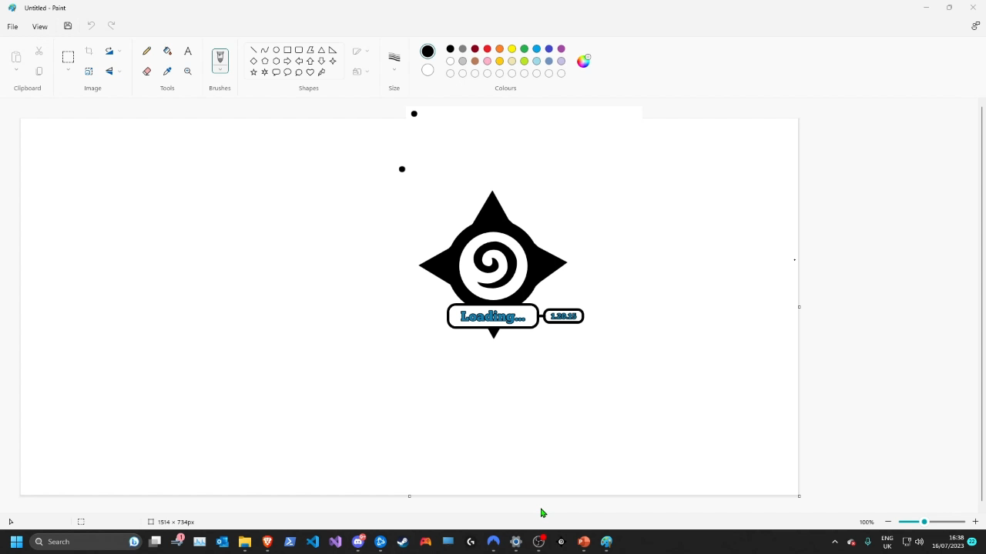

Slide 5
2 – Initial GUI
When you start a match, GUI will start saying no match found
Alongside a coloured indicator of the rank it is using in its API calls
Using your current rank, or maxing out at Gold for free/non logged in accounts

Slide 7
3 – GUI for a Match
Every time opponent plays a card, it will check against HSReplay.net list of meta decks for the best fitting decklist
If a match above 50% is found, it displays:
winrate of that deck vs your best fit for your deck
Percentage match of their played cards vs the deck
The decklist of cards + card info (on hover)
As well as an indicator of the rank from which this data was gathered

Slide 8
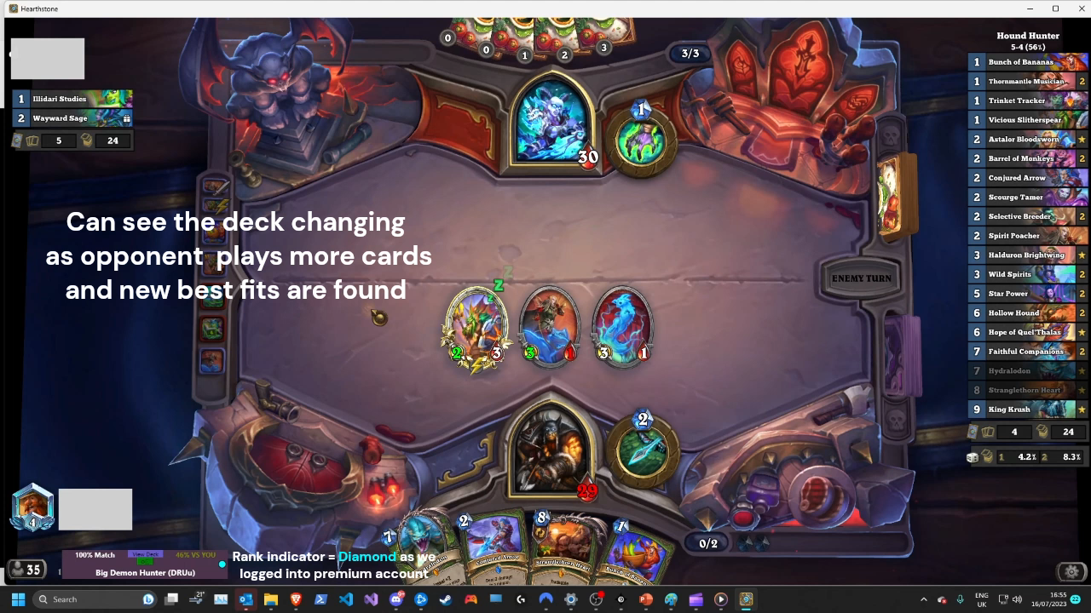

Slide 9
4 – Free acc or closing login
When the plugin is loaded and you are prompted to login to HSReplay, if:
1. You login with a free account
2. You close the chrome window + cmd window
3. You wait for the 120 second timeout to expire
You will still be able to use the plugin but the stats will max out at Gold rank
E.G. if your rank is Platinum, Diamond, or Legendary; you will see stats from Gold

Slide 10
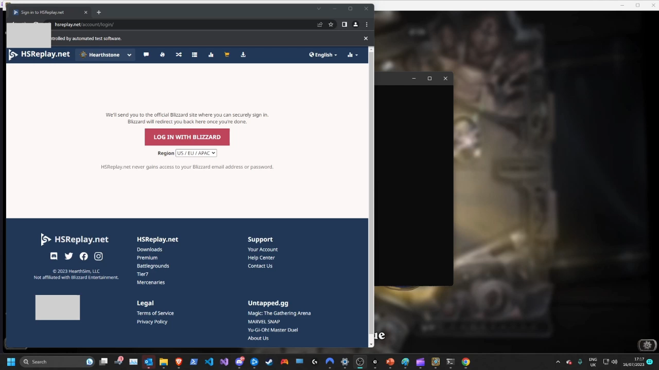

Slide 11
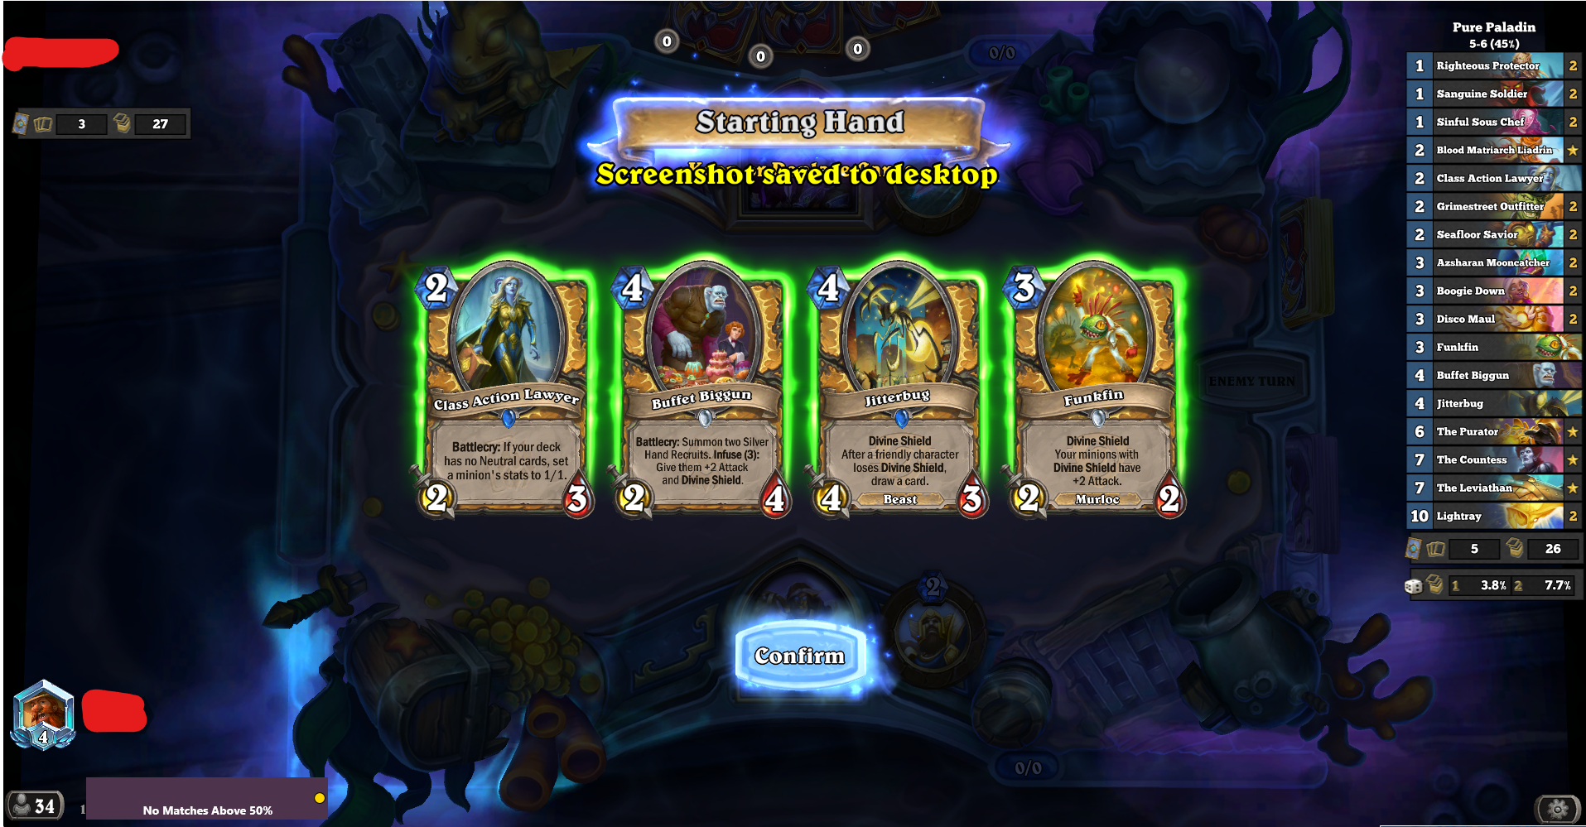
Can see despite being a Diamond Game, as we didn't login it is showing us stats from Gold

